Slide 1
AUTOMATION OF ASSEMBLY LINES ASSISTED BY A ROBOTIC ARM AND A MOBILE ROBOT
Balteș Octavian-Isaia
Lucian Blaga University of Sibiu
octavian.baltes@gmail.com

Slide 2
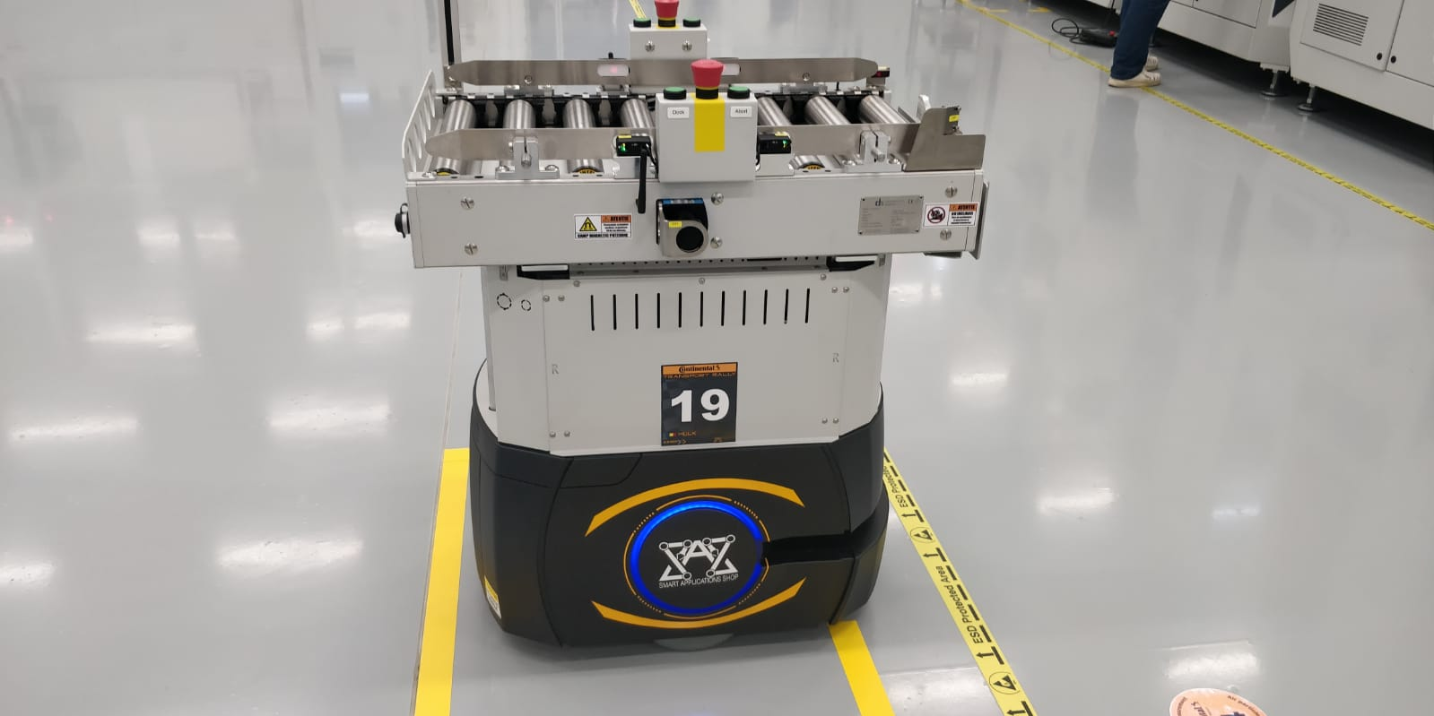
Objectives
Simulation of assembly line automation using modeling languages.
Handling a robotic arm and a mBot.
Creating the model to solve the problem.
Writing the code to solve the problem.
Prototype to simulate the AGVs in logistic processes.

Slide 3
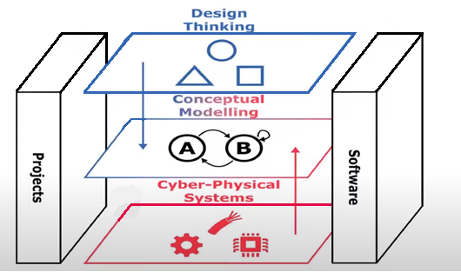
The 3 main approaches suggested by OMiLAB

Slide 4
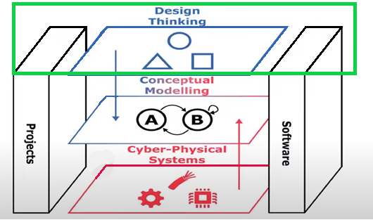
Design Thinking

Slide 5
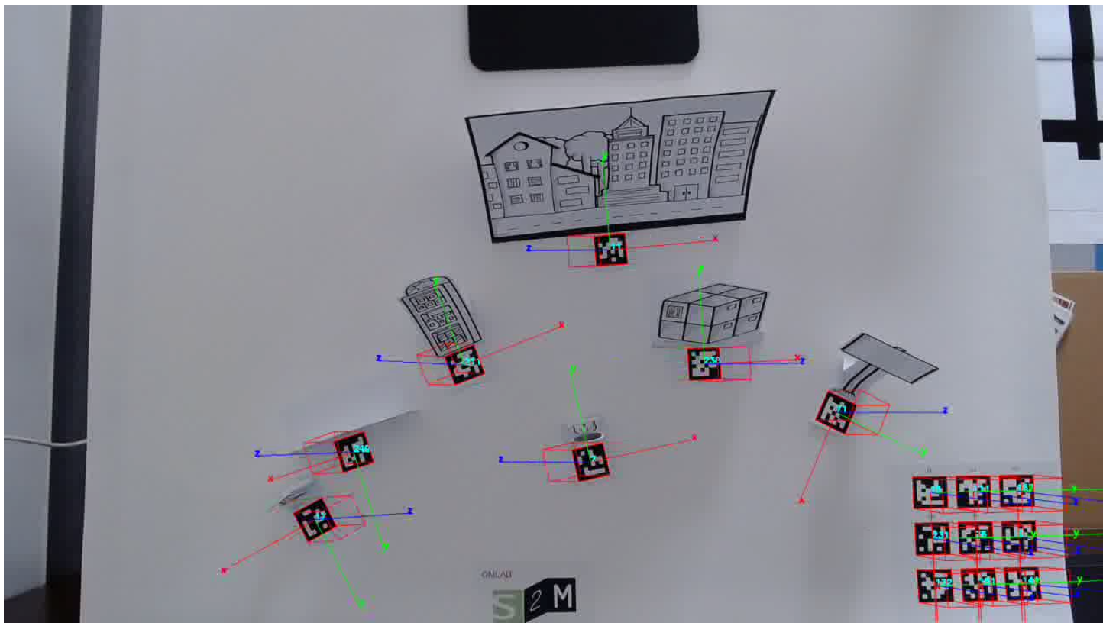
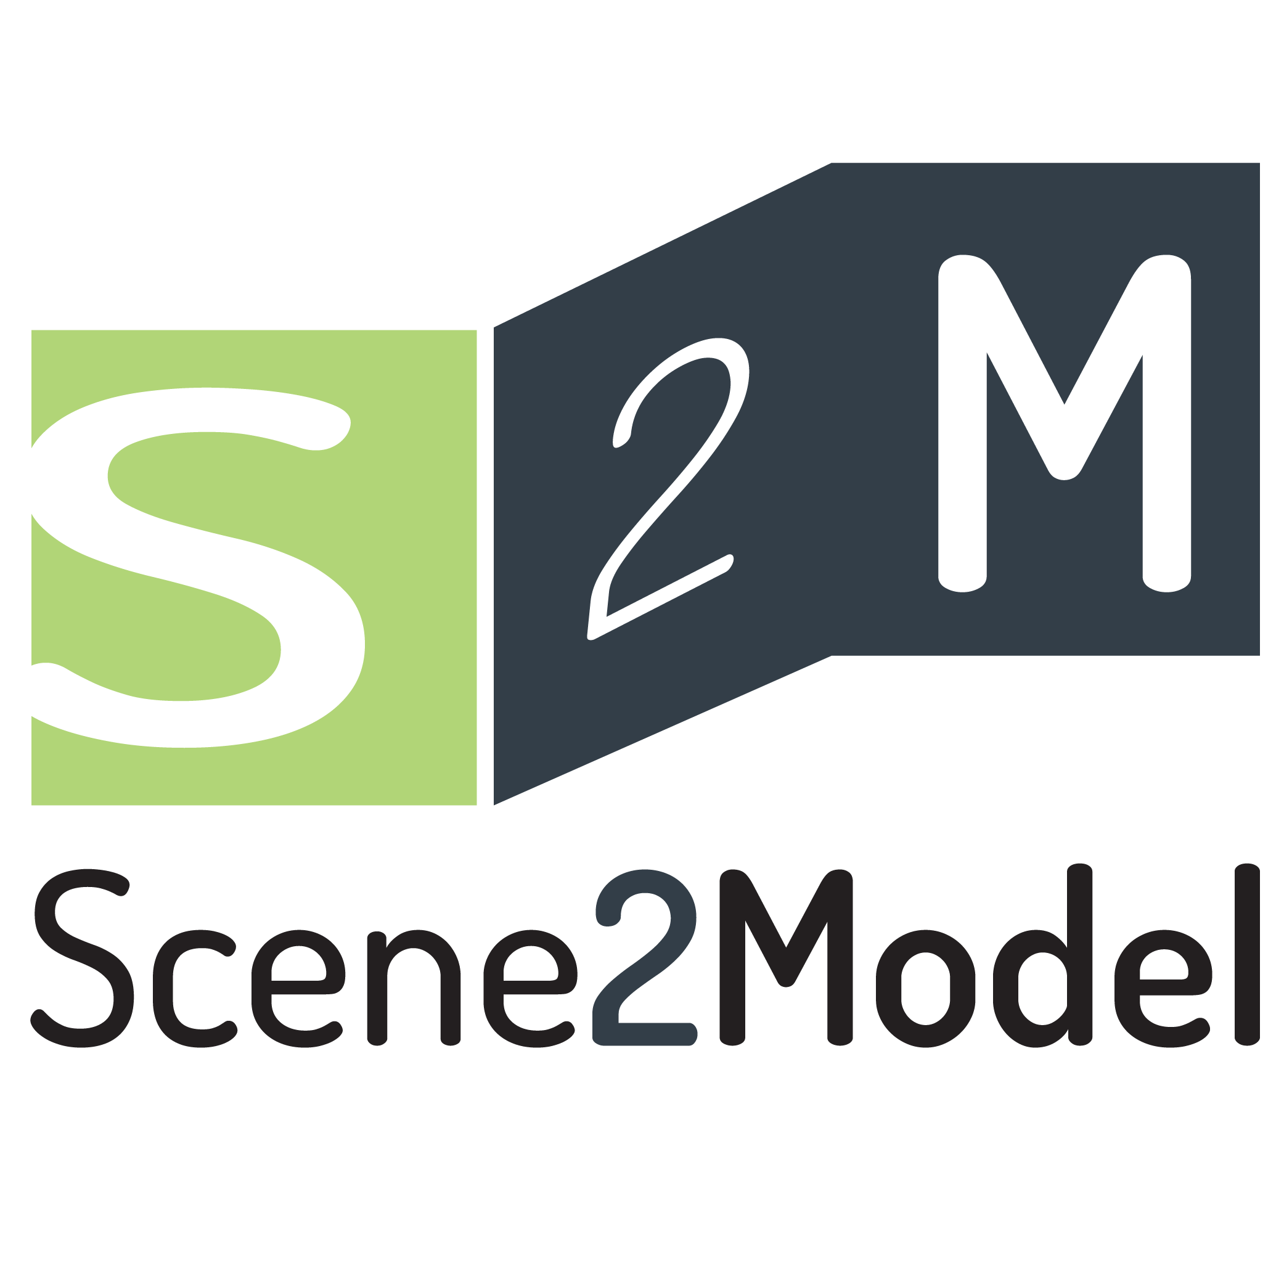
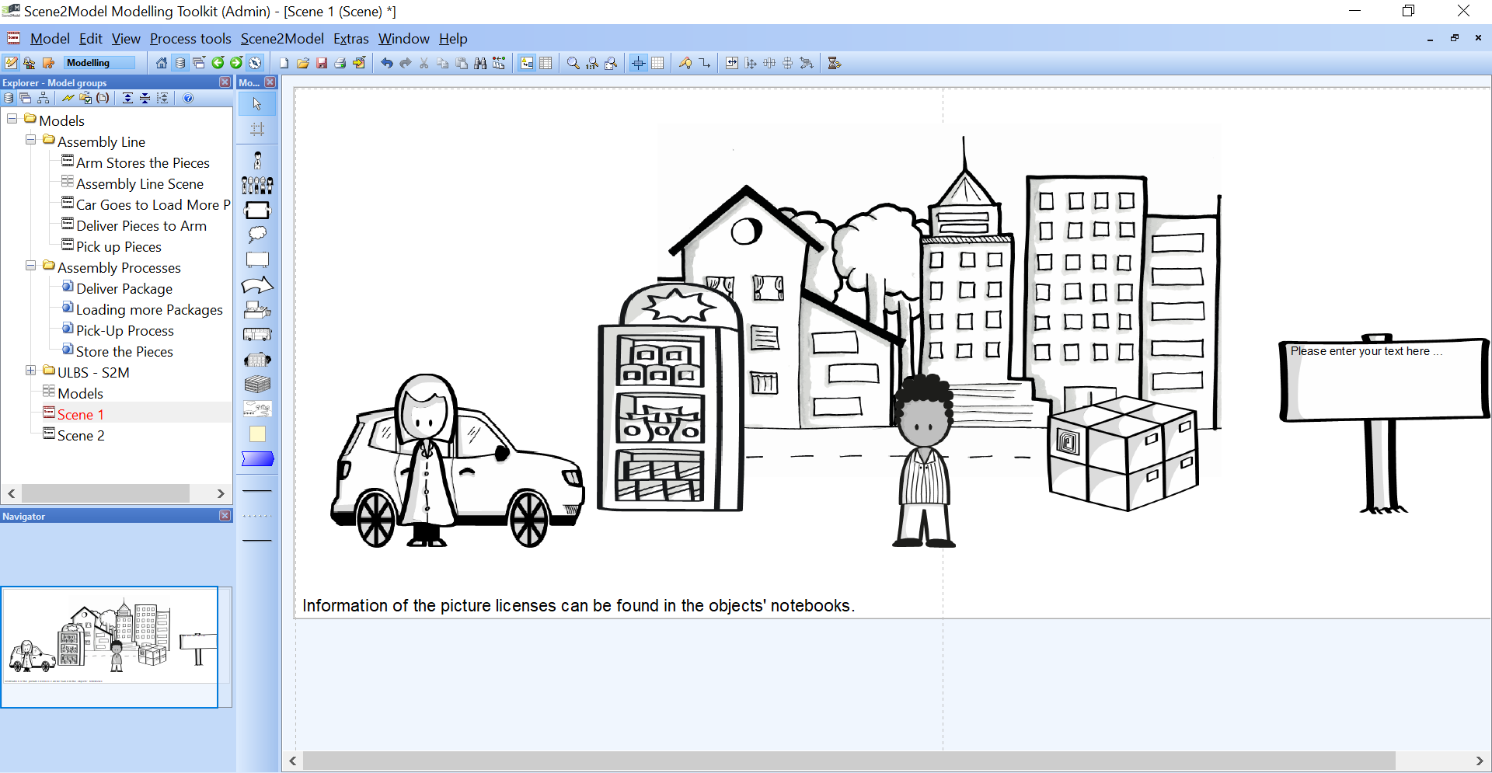

Slide 6
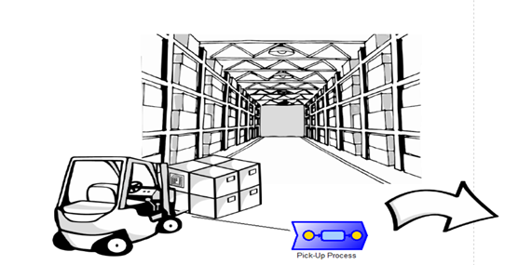
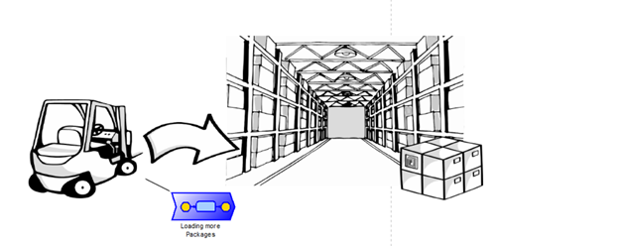
Scene 1 - Pick-up
Scene 2 - Deliver
Scene 4 - Reload
Scene 3 - Store

Slide 7
Storyboard

Slide 8
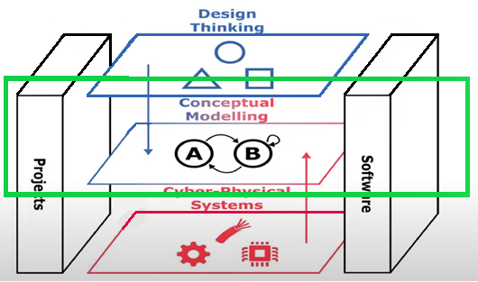
2. Conceptual Modelling

Slide 9
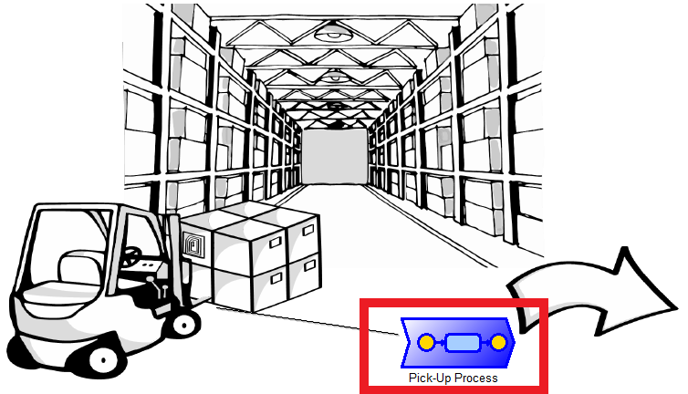

Slide 10
Scene 1 - Pick-up
Scene 2 - Deliver
Scene 4 - Reload
Scene 3 - Store

Slide 11
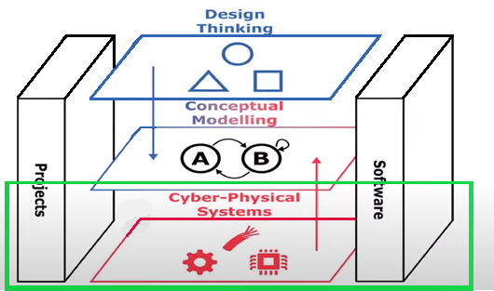
3. Cyber-Physical System

Slide 12
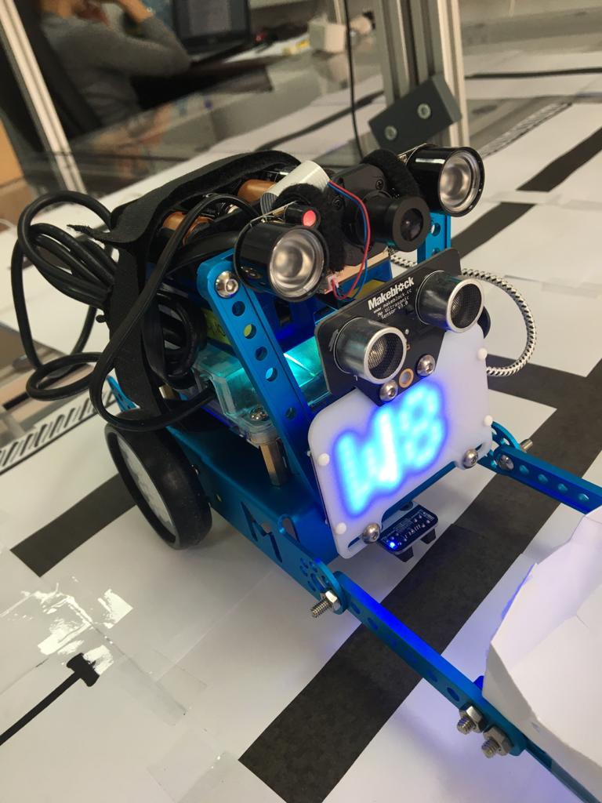
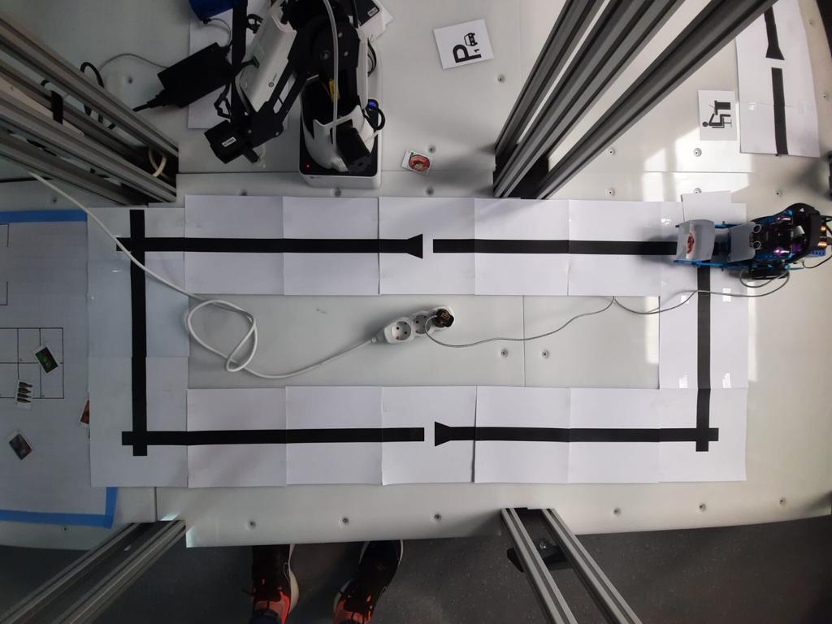
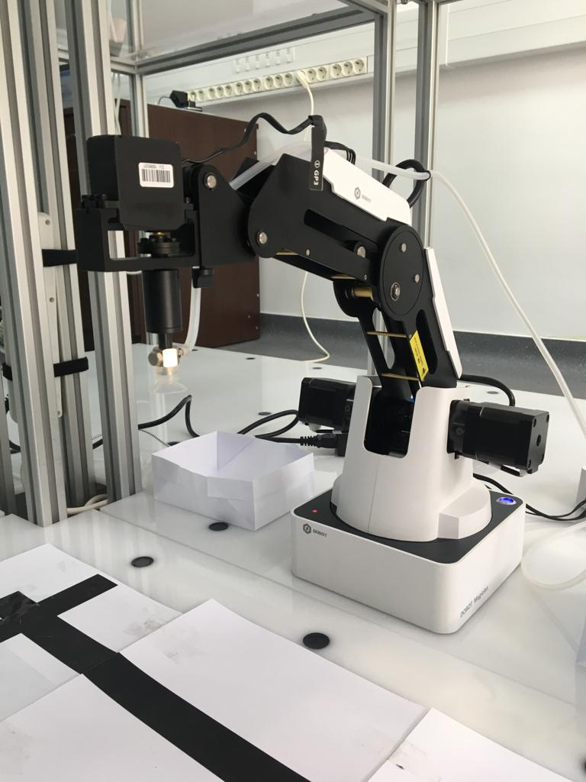

Slide 13
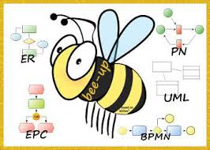
Sub-models used to create the main model.
The complete model of the application.

Slide 14
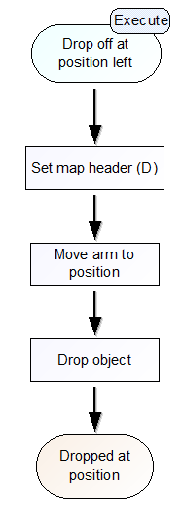

Slide 15
Conclusions and further developments
I believe that this type of project has wide applicability and can be successful in industrial companies.
From a software point of view, I used Bee-Up as a tool for the CPS part and the Flowchart as a working method, and for the Design Thinking and Conceptual Modeling parts I used Scene2Model.
In the future, I want to make the robotic arm smarter, attaching a camera so that the parts are separated based on QR codes. Apart from the automation problem, I want to make a project in which the arm is used as a 3D printer.
As for the mBot, I want to attach at least 2 proximity sensors so that it can move alone on an obstacle course.

Slide 16
References
Dimitris Karagiannis, Heinrich C. Mayr, John Mylopoulos – “Domain-Specific Conceptual Modeling”
Bee-Up Tool : https://austria.omilab.org/psm/content/bee-up/info
Scene2Model Tool : https://austria.omilab.org/psm/content/scene2model/info
ADOxx : https://www.adoxx.org/live/home
OMiLAB Approach : https://www.omilab.org/assets/docs/OMiLAB%20Laboratory%20Layout_DRAFT.pdf

Slide 17
Thank you for your attention !

